Slide 1


Formal Analysis and Applications of Direct Anonymous Attestation
14th November 2018
RISE Annual Conference
Jorden Whitefield
sudo_jorden
j.whitefield@surrey.ac.uk

Slide 2
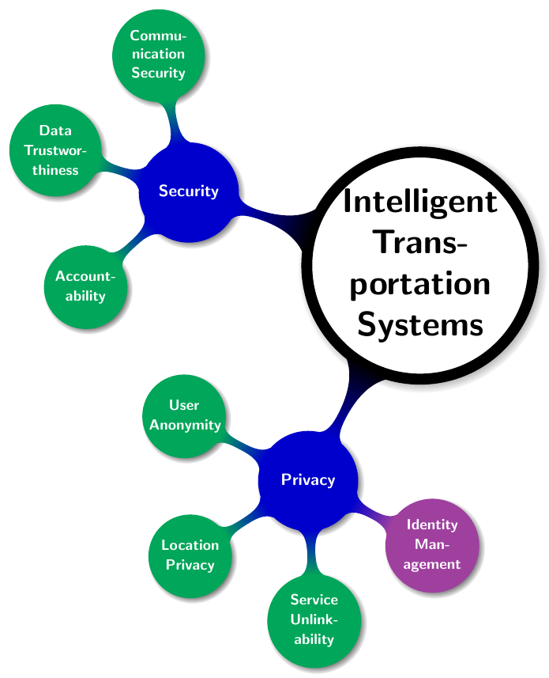
Intelligent Transportation Systems: Security & Privacy Challenges
Protect the users from the System (i.e., privacy)
Anonymity (conditional)
Pseudonymity
Unlinkability
Unobservability
Protect System from the Users
Authentication & Authorisation
Accountability
Data Trustworthiness
Contradictory position between users and infrastructure
Image source: “Trustworthy People-Centric Sensing: Privacy, Security and User Incentives Road-Map”

Slide 3
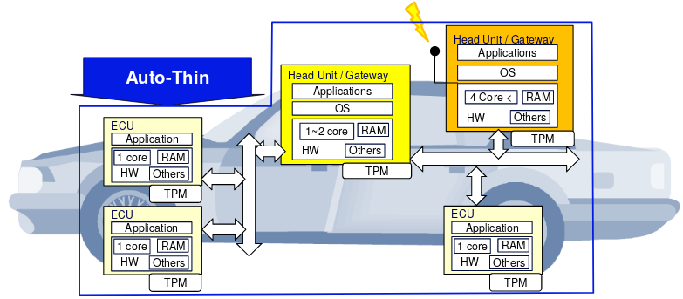


Direct Anonymous Attestation
Anonymous Digital Signature scheme
Strong but privacy-preserving authentication
Hardware-backed attestation using Trusted Platform Modules (TPM)
Properties of DAA:
Correctness
Valid signatures only producible by honest platforms, and are verifiable and linkable where specified.
User-controlled Anonymity
Identity of a user cannot be revealed from signature.
User-controlled Traceability
Host controls whether signatures can be linked.
Standardised in ISO/IEC 20008 2013

Slide 4
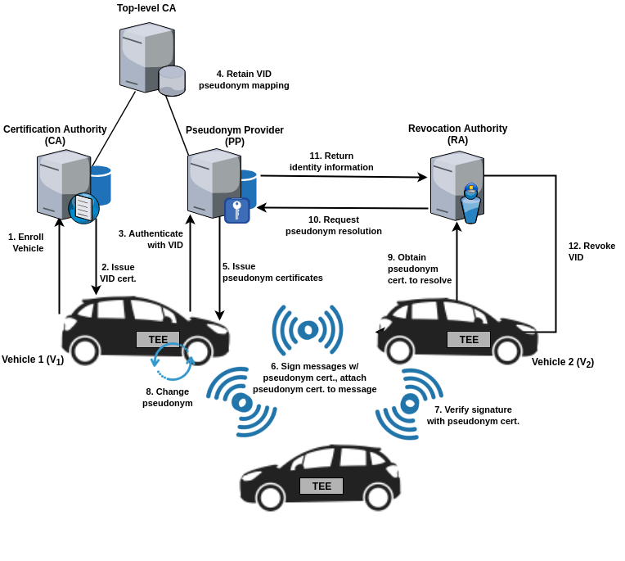
Vehicular Pseudonym System - VPKI

Slide 5
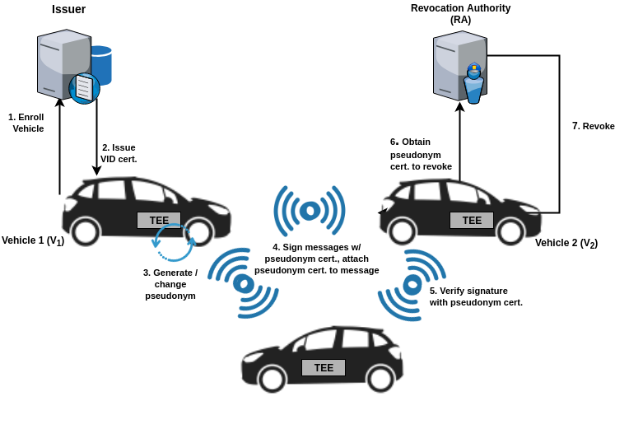
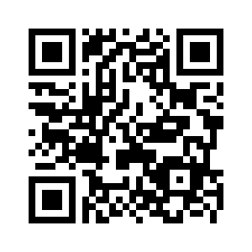
Vehicular DAA Pseudonym System
“Privacy-Enhanced Capabilities for VANETS Using Direct Anonymous Attestation.” In 2017 IEEE Vehicular Networking Conference, VNC 2017

Slide 6
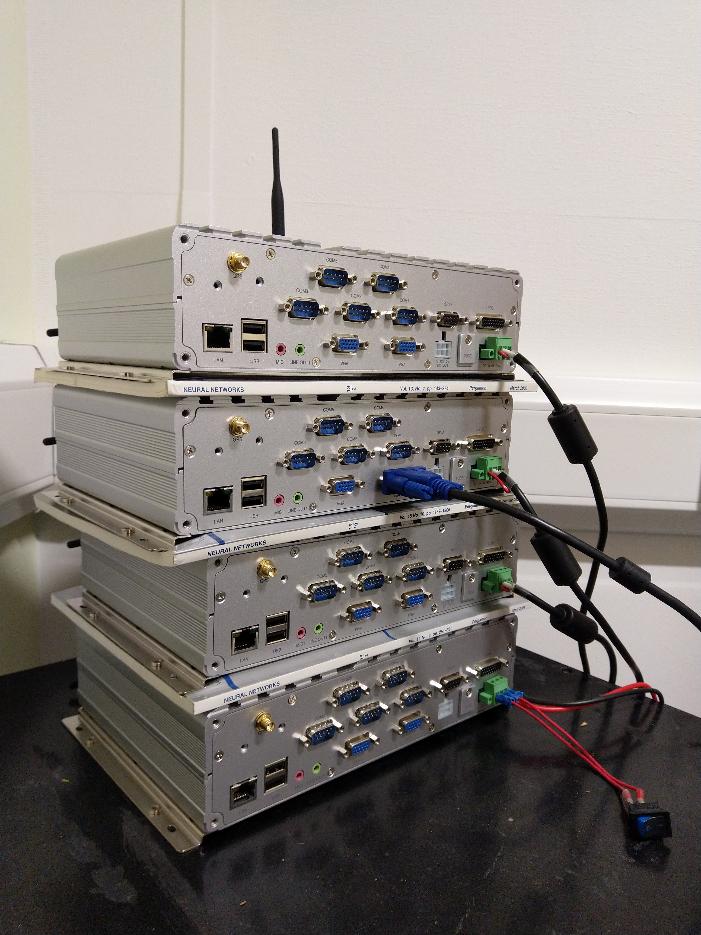
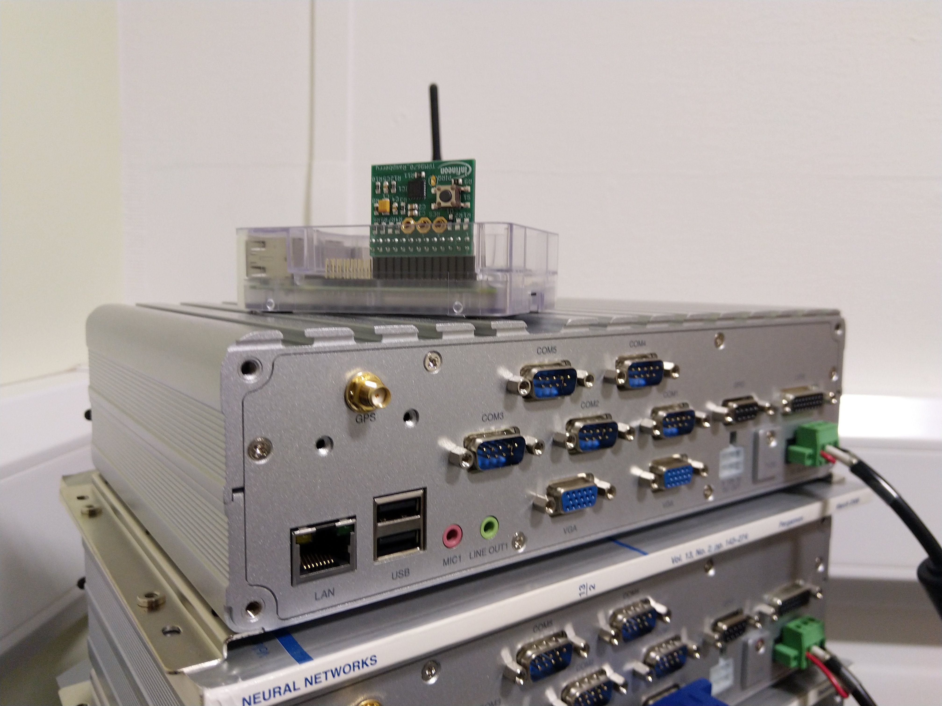
EPSRC UK Funded Project
Demonstrate the applicability of our DAA V2X architecture
Project in collaboration with
Thales UK
Thales eSecurity
Pervasive Intelligence
Nexcom VTC 6200
Intel Atom D510 Dual Core 1.6GHz
2GB RAM

Slide 7




Preliminary Results
CREATE: 10 ms
SIGN: 84 ms
VERIFY: 510 ms
Implementation details
HOST: Java
TPM: Raspberry Pi Model B
Infineon development TPM
C with IBM TSS
ISSUER: Java Spring
ETSI Standards 100 to 150 message per second

Slide 8


Formal Analysis Summary
Proofs and Disproofs obtained using the Tamarin Prover
https://tamarin-prover.github.io/
Found an attack when the integrity of one TPM is compromised, the security of all TPMs cannot
be guaranteed.

Slide 9

@sudo_jorden
jwhitefield.co.uk

